Slide 1




Scaling DevOps Deployments with AWS CodePipeline and Dynatrace AppMon
Followed by Live Q&A
Part of Dynatrace Performance Clinic Series
Get Dynatrace AppMon: http://bit.ly/dtpersonal
Ask questions using the Questions Tab – or post on answers.dynatrace.com
Rob Jahn
Sr. Consultant @ CGI
@RobJahn45
Joe Sicree
Sr. Consultant @ CGI
@JoeSicree
Daniel Freij
Sol. Engineer @ Apica
@DanielFreij
Andi Grabner
DevOps @ Dynatrace
@grabnerandi

Slide 2
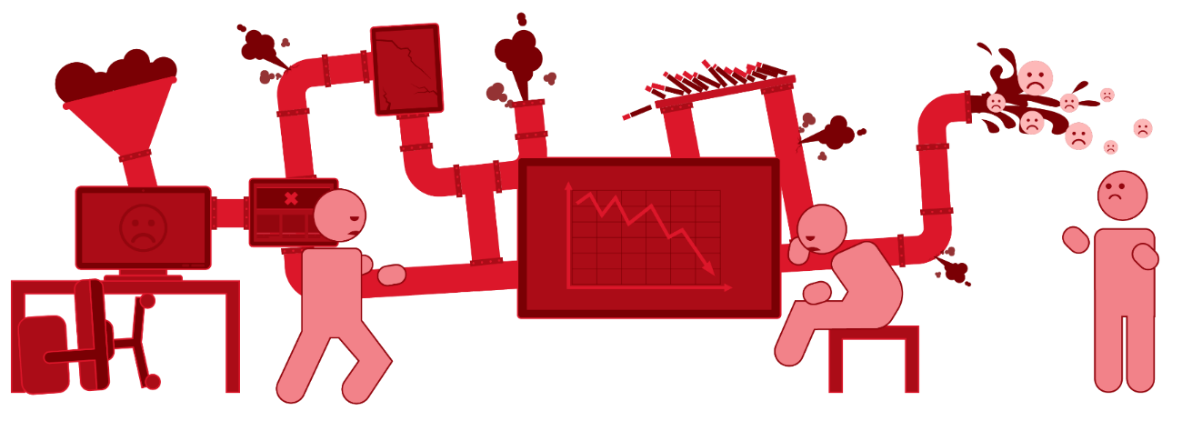
AWS does NOT PREVENT your teams from pushing bad code through the pipeline more frequently!
Dev&Test: Trial & Error Check-In Mentality!
Ops/Biz: Bad Code Changes make it to Production. Impact End Users and Resource Usage
Test / CI: Basic Tests that only test high-level functionality!
Performance: Too many code commits leads to skipping performance testing to save time
Notes:
Pipelines may lead to developers to start a „Trial & Error“ Mentality. Simply check in code and lets see how it works in production. They may even change unit tests so that they succesfully execute just in order to get through the pipeline. You may even see load tests being skipped just to make the deadline!

Slide 3
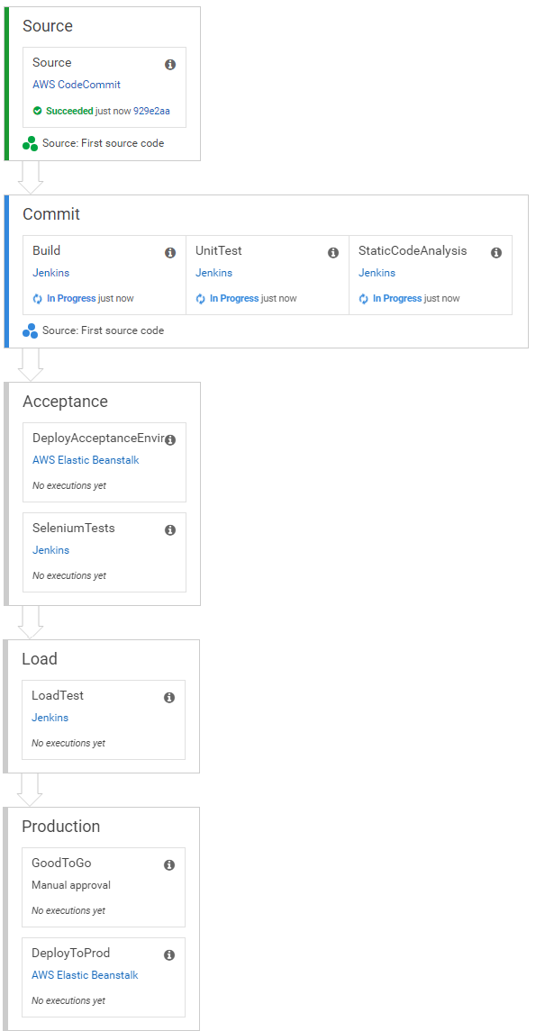


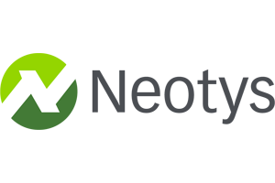

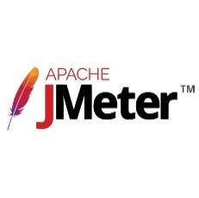




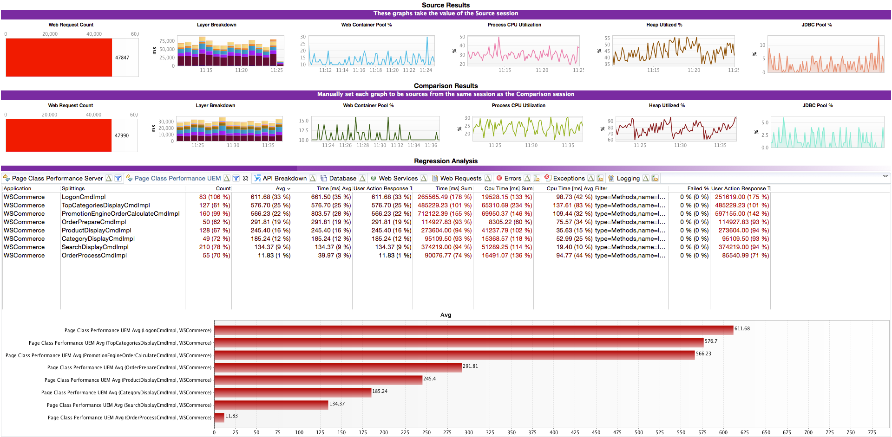
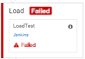
Dynatrace: Automatic Performance Analysis across Load Tests
Auto Regressions and Root Cause Analysis across Tests
Notes:
If you run load tests we automatically detect root cause within a single test but also detect regressions across tests. This not only speeds up your load testing phase but also helps you detect regressions from build-to-build faster

Slide 4


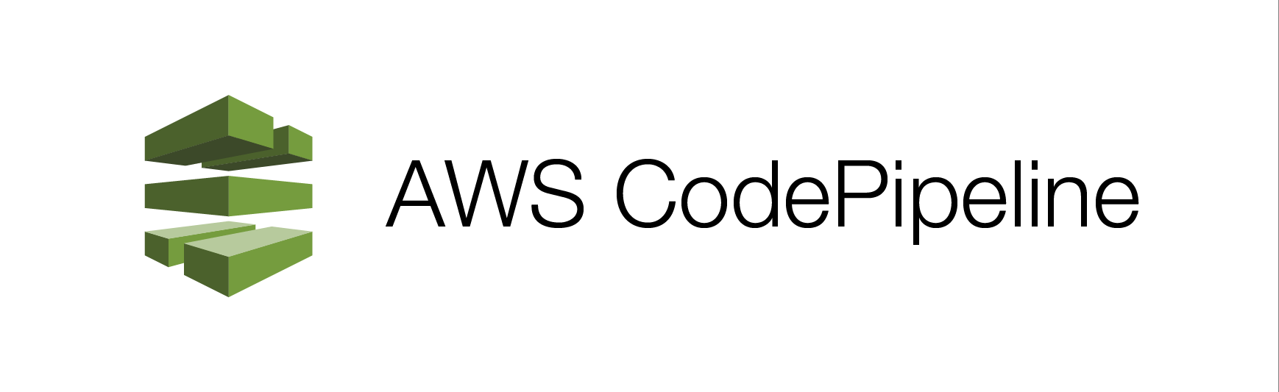






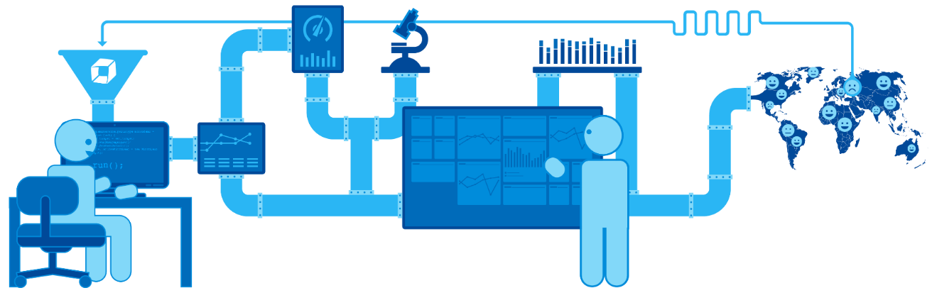
Scaling Continuouos Innovation with Dynatrace on AWS: Shift-Left Quality, Reduce Lead Time & Increase Flow
Dev&Test: Check-In Better Code
Ops/Biz: Monitor End User and Resource Health
Test / CI: Stop 80% of Bad Builds Early
Performance: Production Ready Checks on Good Builds Only!
Notes:
Dynatrace allows you to Scale your Pipeline. Whether you run it full yon the Amazon or in hybrid Pipelines, e.g: using Jenkins or other tools such as XebiaLabs, Electric Cloud, SauceLabs, ...

Slide 5


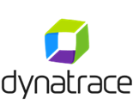







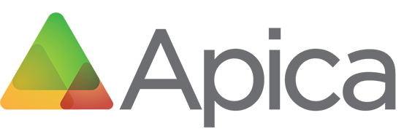
Today’s Goal: Full AWS CodePipeline Demo!
Perf Demo Pipeline
Code changes pushed to branch trigger the pipeline…
AWS CodePipeline
Source
Amazon EC2
Dynatrace Collector
Dynatrace Server
Stage 1
Collect and package source code
Amazon S3
Source Code (.zip)
Build
Stage 2
Build and unit test
Build Artifacts (.zip)
AWS Elastic Beanstalk
Perf Demo
Web Application
(Linux / Tomcat)
AWS CodeBuild
Deploy
Stage 3
Deploy to the target environment
AWS Elastic Beanstalk
Amazon RDS
LoadTest
Test Script
Apica Jobs and
Test Results
Perf Demo
Database
(mySQL)
Stage 4
Execute automated load tests

Slide 6
Agenda
Introduction of Speakers
What is AWS CodePipeline?
How does Apica LoadTest and Dynatrace AppMon fit in?
Live Demo: 3 Performance Engineering Use Cases
Live Q&A

Slide 7


”Helping companies with their end-user experience
focusing on availability and performance”
SaaS
Hybrid
On-Premise
Notes:
Apica –
Helping companies with their end-user experience
focusing on availability and performance

Slide 8



Global Offices
Stockholm
London
New York
Santa Monica
Founded in 2005
500+ Customers
Notes:
Company intro + Story

Slide 9
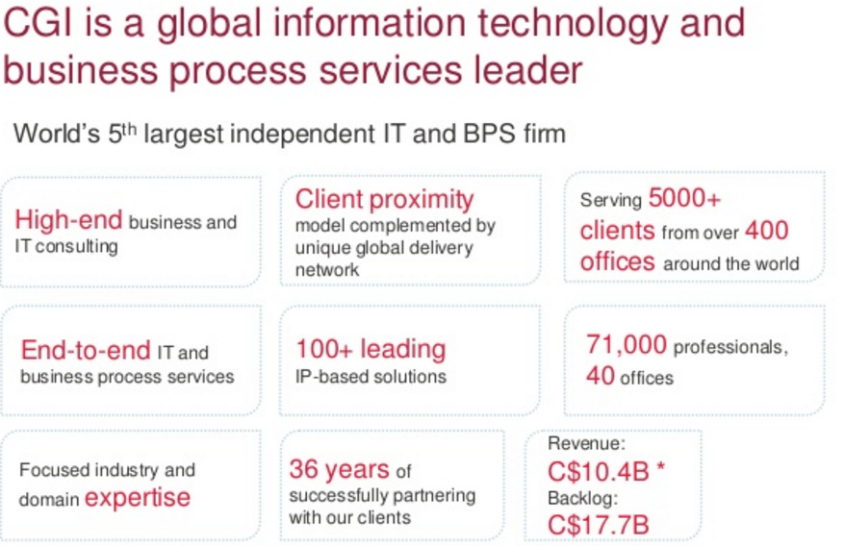

Slide 10
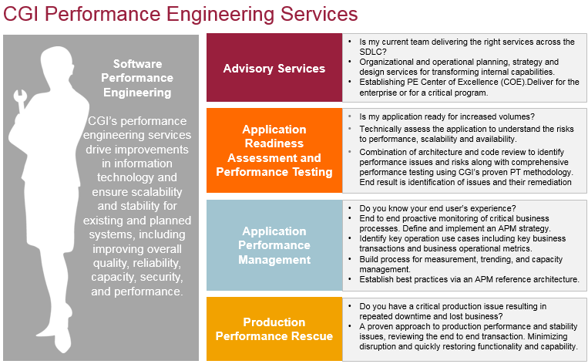

Slide 11
What is AWS CodePipeline? How does Apica Load and Dynatrace fit in?

Slide 12
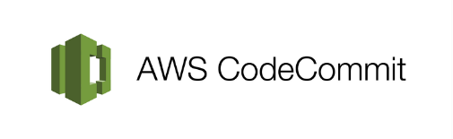











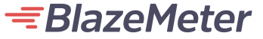


Source
Build
Deploy
Test
Deploy
Notes:
Dynatrace integrates in several phases of the pipline

Slide 13

Make yourself familiar with …
AWS CodePipeline: https://aws.amazon.com/codepipeline
Apica SaaS and Zebra Tester: https://www.apicasystem.com/load-testing/
Dynatrace AppMon & UEM: http://bit.ly/dttutorials

Slide 14
DEMO TIME!

Slide 15
Demo Overview
The following demo will walk us through a simple pipeline for a web application called Perf-Demo.
The demo will focus on the following use cases:
Missed Service Level Agreements (SLA) for a mix of transactions
Memory leaks
Poor performance when accessing a database
The demo will use a simple web application to demonstrate these use cases.

Slide 16
Demo Application
Java Spring web application that provides a number of REST web services for use in performance testing.
The web application provides the following services:
calculateCompoundInterest – Calculates compound interest for one or more accounts over a specified time period.
addDataToMap – Populates a hash map with data using a simple key
getFinancialRecordsByDate – Fetches financial data for one or more stocks on a specified date.
AWS Elastic Beanstalk
Perf Demo
Web Application
(Linux / Tomcat)
Amazon RDS
Perf Demo
Database
(mySQL)
Get the code at https://github.com/jsicree/perf-demo

Slide 17
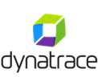


Demo AWS CodePipeline
Perf Demo Pipeline
Code changes pushed to branch trigger the pipeline…
AWS CodePipeline
Source
Amazon EC2
Dynatrace Collector
Dynatrace Server
Stage 1
Collect and package source code
Amazon S3
Source Code (.zip)
Build
Stage 2
Build and unit test
Build Artifacts (.zip)
AWS Elastic Beanstalk
Perf Demo
Web Application
(Linux / Tomcat)
AWS CodeBuild
Deploy
Stage 3
Deploy to the target environment
AWS Elastic Beanstalk
Amazon RDS
LoadTest
Test Script
Apica Jobs and
Test Results
Perf Demo
Database
(mySQL)
Stage 4
Execute automated load tests

Slide 18
Demo #1 – Slow Services
The Service
The computeCompoundInterest service computes the compound interest for a collection of accounts for a requested number of monthly or yearly intervals.
The Problem
The initial load test for the service using a mix of 3, 6, 9 and 12 accounts showed that the average response time was above the expected SLA for the requests with more accounts.

Slide 19
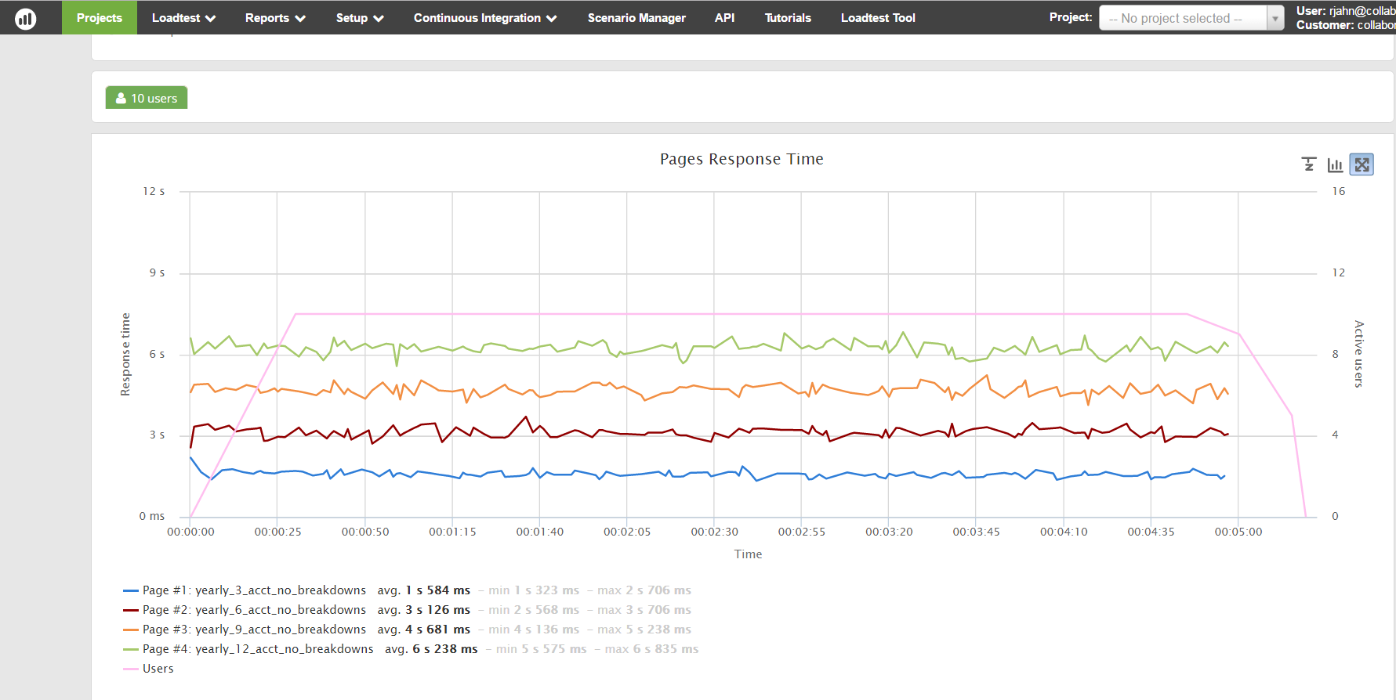
Demo #1 – Slow Services (V1 Test)
Exceeding SLA for Response Time

Slide 20
Demo #1 – Slow Services (cont.)
The Analysis
The underlying service was implemented synchronously. The more accounts included in the request, the longer the web service call took.
The Solution
The service was refactored to run asynchronously using threads.

Slide 21
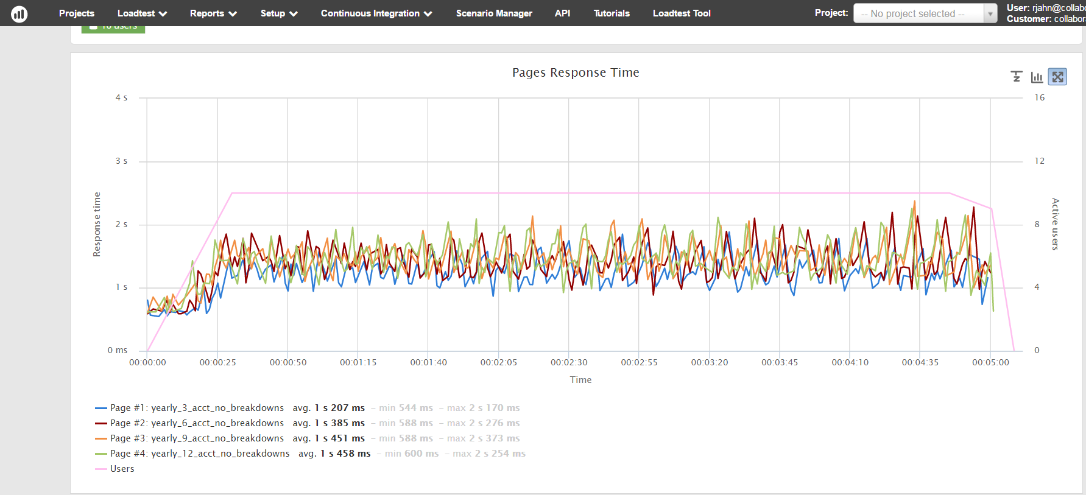
Demo #1 – Slow Services (v2 Test)
All calls are under the 3 second SLA

Slide 22
Demo #2 – Memory Leak
The Service
The service addDataToMap adds a specified block of bytes to a hash map using a simple key.
The Problem
The initial load test for the service showed that memory usage continuously increased, eventually causing an OutOfMemory error.

Slide 23
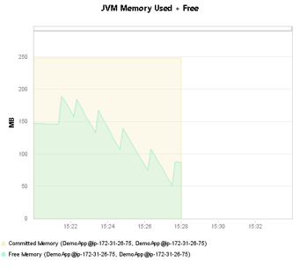
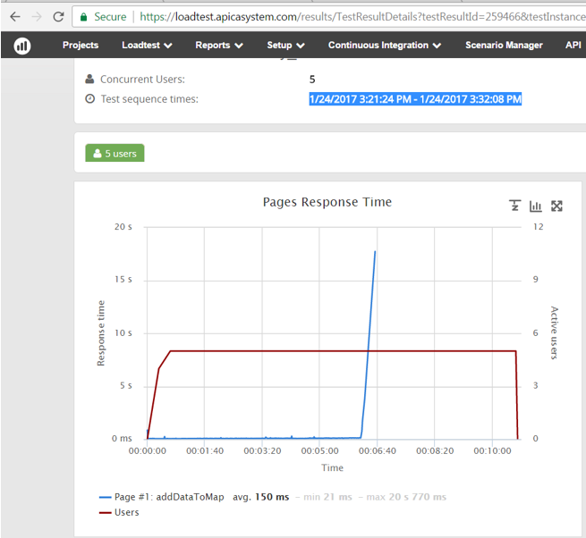
Demo #2 – Memory Leak (V1 Test)
Out of Memory caused server to crash. Timeout of request as a result

Slide 24
Demo #2 – Memory Leak (Cont.)
The Analysis
Service was implemented with a key class that did not implement an equals() method. As data was added to the map by each service call, values in the hash map were not being overwritten as intended. Instead, the new values were being appended to the map. This resulted in a memory leak that eventually led to OutOfMemory errors.
The Solution
The bad key class was refactored.

Slide 25
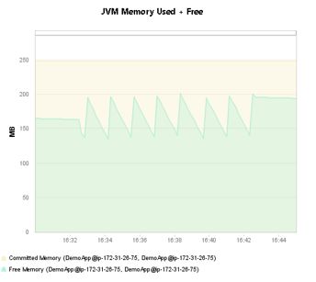
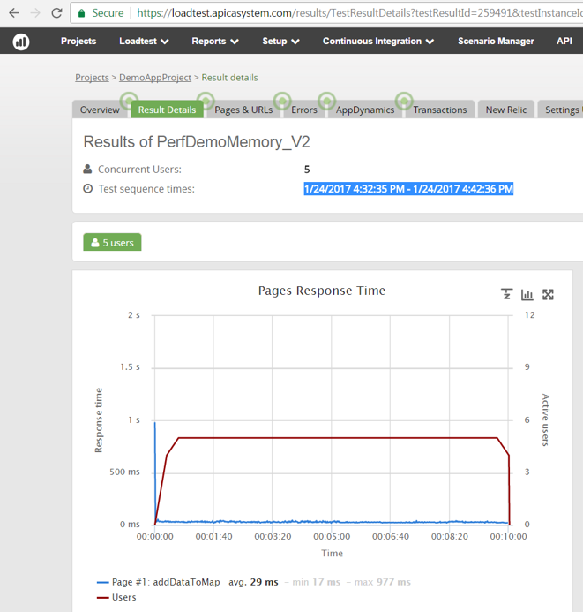
Demo #2 – Memory Leak (V2 Test)
Before
(v1)
After
(v2)

Slide 26
Demo #3 – Poor DB Performance
The Service
The service getFinancialRecordsByDate fetches financial data for a specified list of stock symbols for a specified date from database tables
The Problem
The initial load test for the service showed that there were a large number of database calls for each service call.

Slide 27
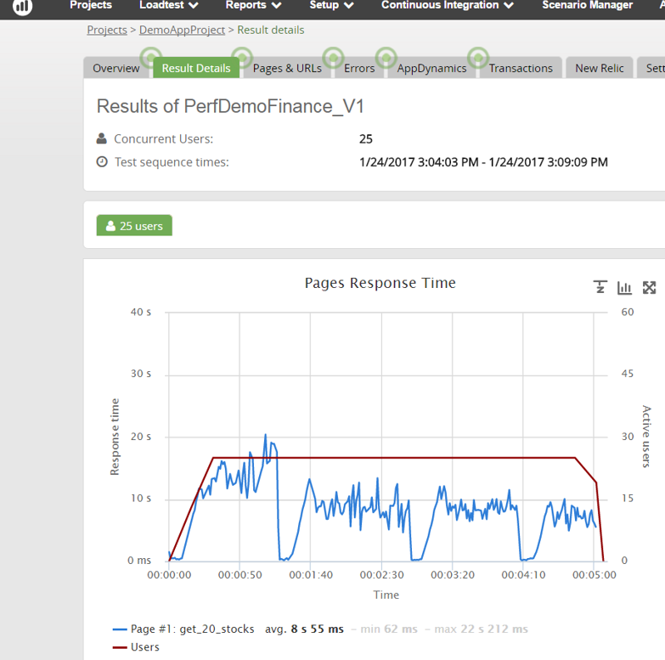
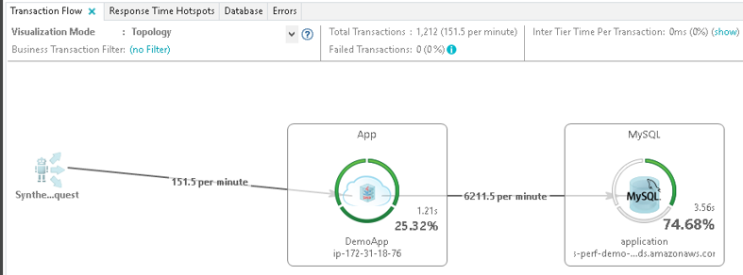
Demo #3 – Poor DB Performance (V1 Test)
Poor Response times and much of the time in the database

Slide 28
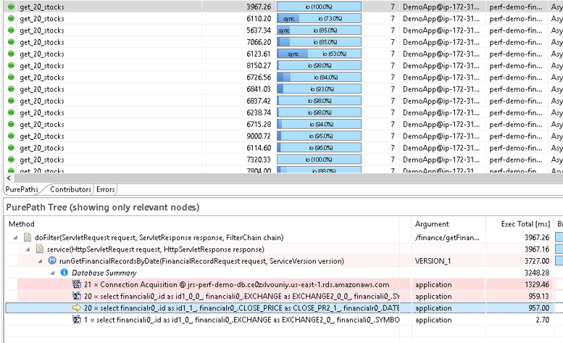
Demo #3 – Poor DB Performance (V1 Test)
41 SQL calls Per Service call.

Slide 29
Demo #3 – Poor DB Performance (cont)
The Analysis
Service suffered from an N+1 query problem where to fetch the data for N stocks, N+1 database queries were made.
The Solution
Refactored to use a SQL join clause to reduce the number of database queries to 1 per service call

Slide 30
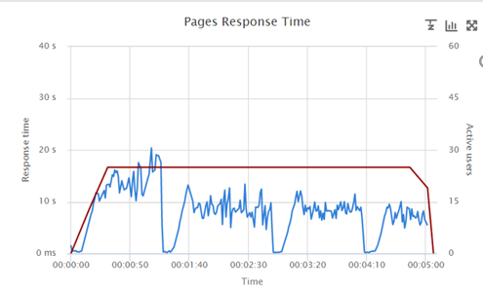
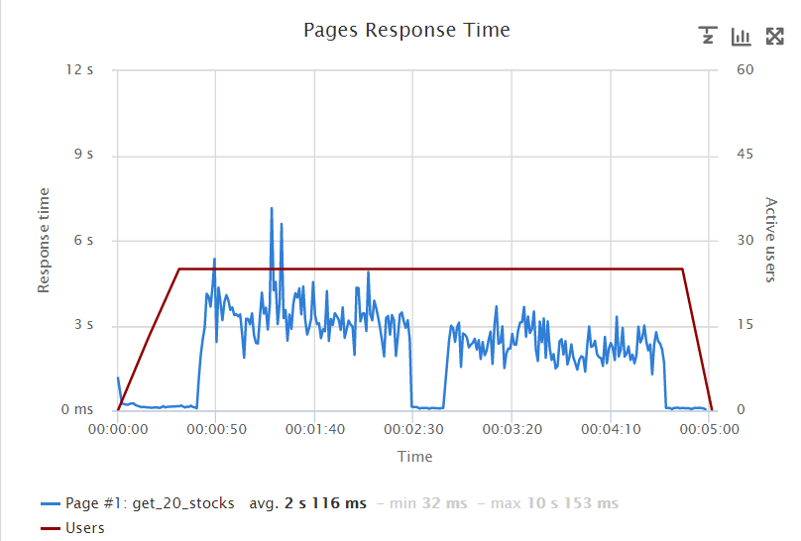
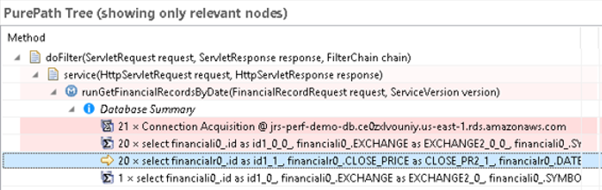
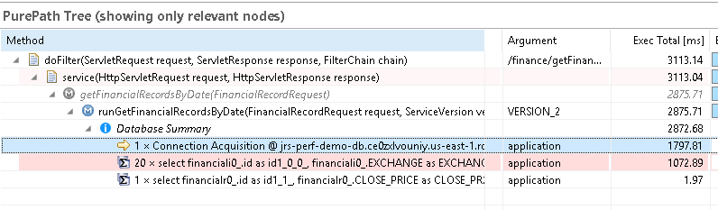
Demo #3 – Poor DB Performance (V2 Test)
Before – 10 sec
After – 3 sec – 20 less SQL calls

Slide 31
Try it yourself!

Slide 32
Follow these simple steps
Setup AWS account for use of EBS, EC2, CodePipeline, CodeBuild: https://aws.amazon.com
Setup Apica SaaS Trial Account: https://www.apicasystem.com/
Setup a Dynatrace AppMon Personal Licence: http://bit.ly/dtpersonal
Fork Demo App Code as to perform Builds and Run it – Readme files have a lot of details - https://github.com/jsicree

Slide 33
Contact reminders …
CGI – http://www.cgi.com
Apica – https://www.apicasystem.com
Dynatrace - http://www.dynatrace.com
Rob Jahn
Sr. Consultant @ CGI
@RobJahn45
Joe Sicree
Sr. Consultant @ CGI
@JoeSicree
Daniel Freij
Sol. Engineer @ Apica
@DanielFreij
Andi Grabner
DevOps @ Dynatrace
@grabnerandi

Slide 34

Event Reminders
Dynatrace PERFORM – Feb 7th to 9th
http://www.cgi.com/perform
YouTube Channel: http://bit.ly/dttutorials
Education & Forums: http://apmu.dynatrace.com & http://answers.dynatrace.com
Dynatrace AppMon Personal License: http://bit.ly/dtpersonal
Share Your PurePath: http://bit.ly/sharepurepath
PurePerformance Podcast: http://bit.ly/pureperf

Slide 35
Open Q&A Use the Question Feature in GoTo Webinar or post it later to http://answers.dynatrace.com

Slide 37
Configuration Details

Slide 38
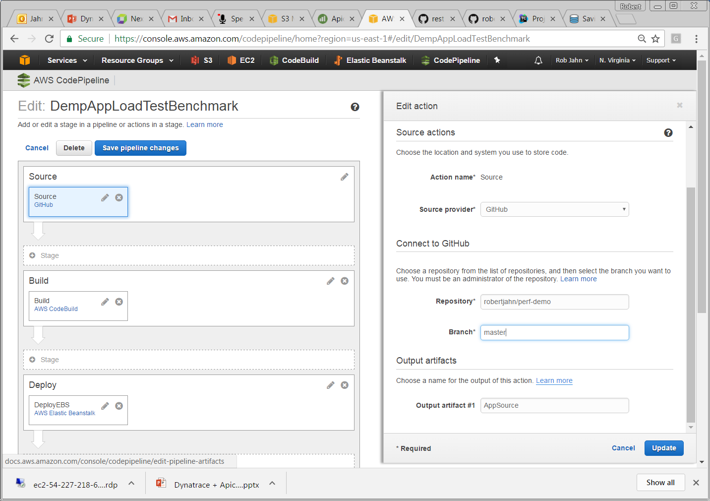
Source Stage in AWS CodePipeline
Commit Triggers the Pipeline!

Slide 39
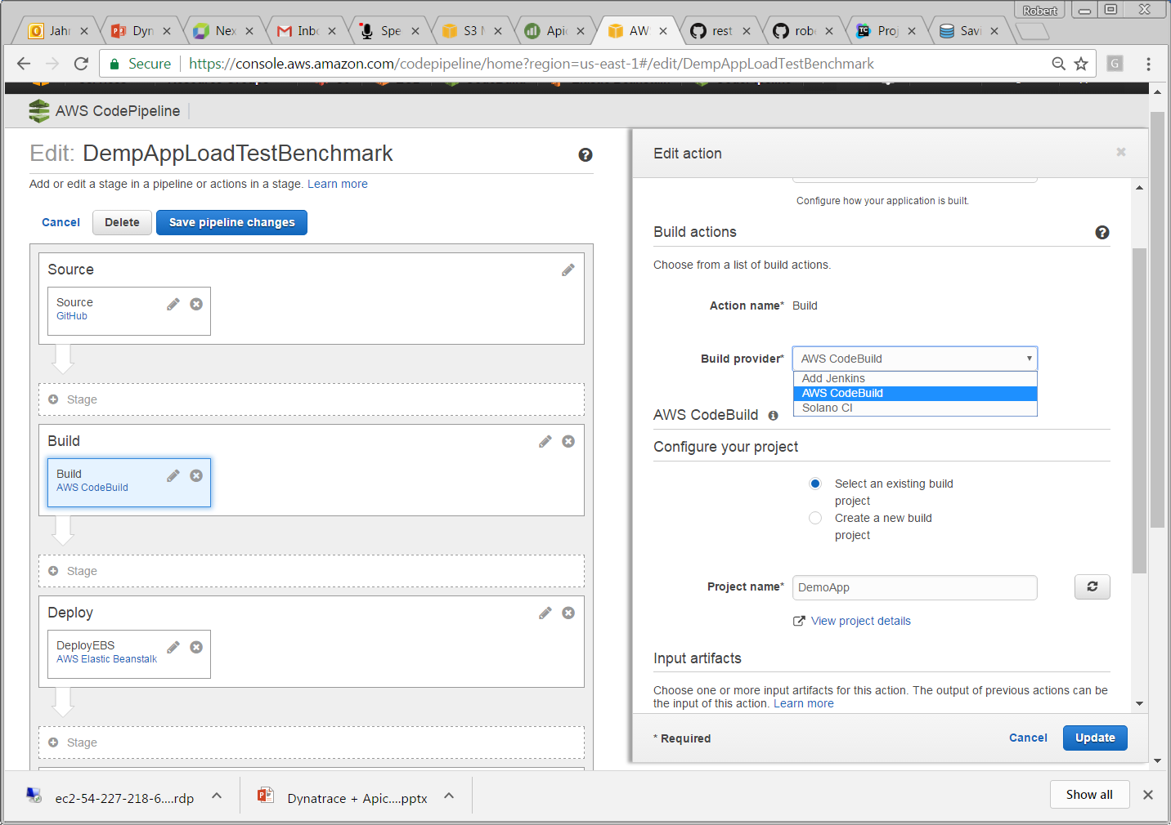
Build Stage in AWS CodePipeline
Trigger AWS CodeBuild

Slide 40
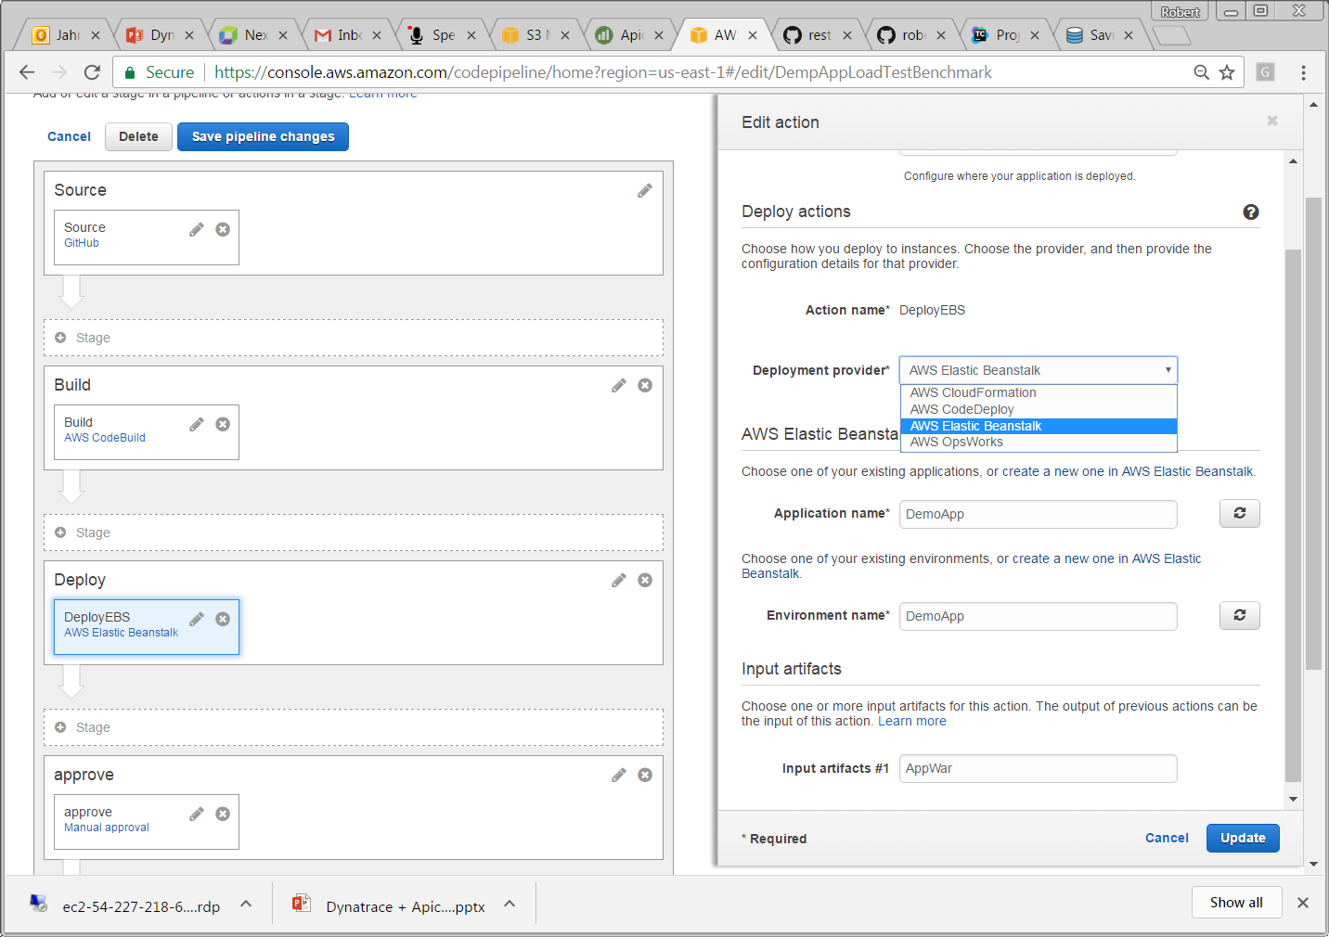
Deploy Stage in AWS CodePipeline
Trigger AWS EBS Deployment

Slide 41
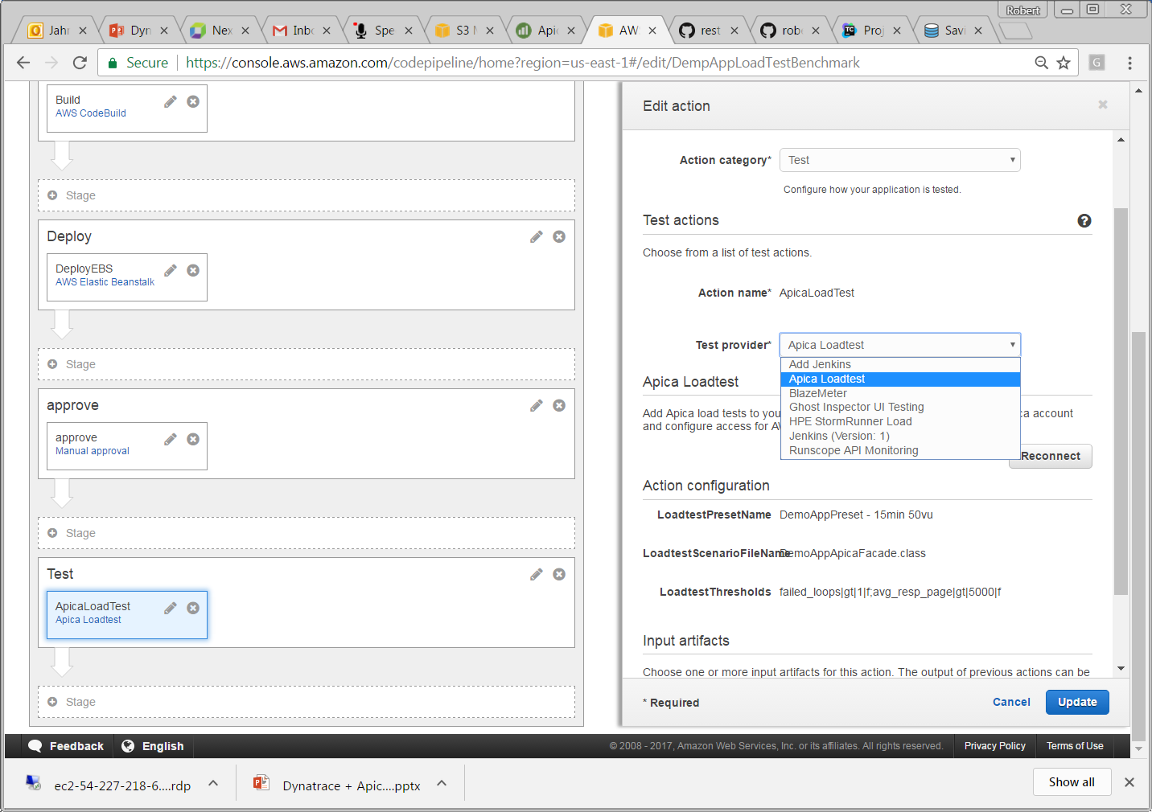
Test Stage in AWS CodePipeline
Trigger Apica Load Test

Slide 42
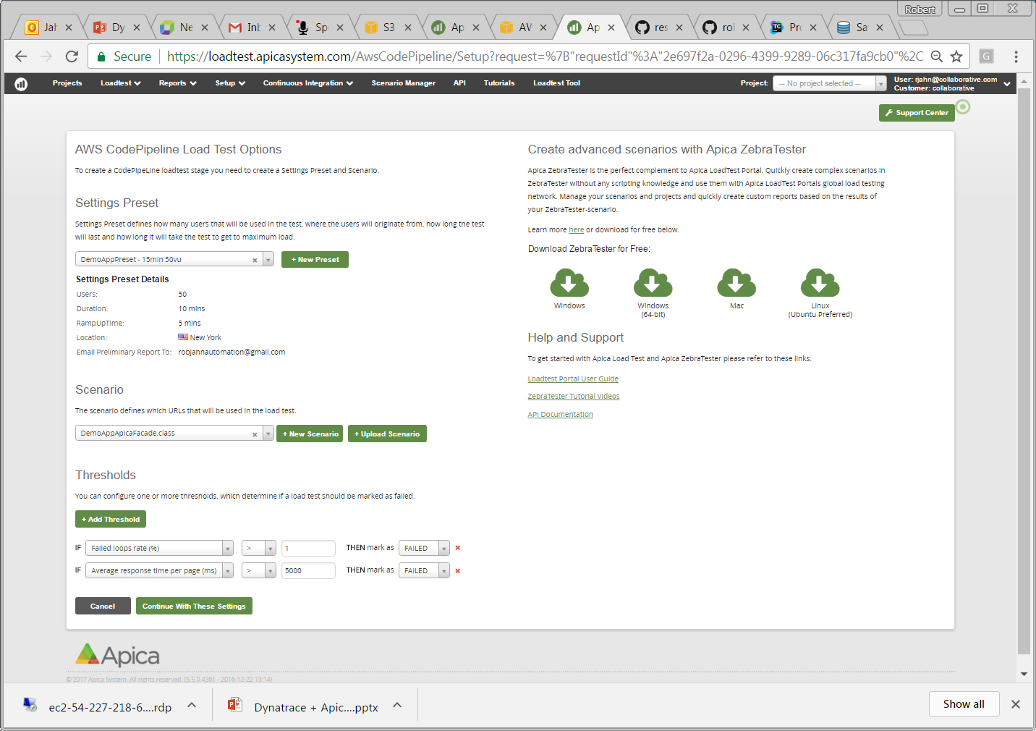
Apica Setup for Test Stage in AWS CodePipeline

Slide 43
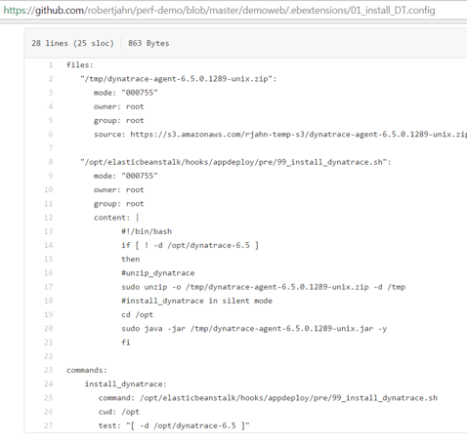
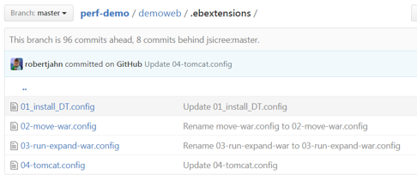
EBS Configuration
To get DT agent on EBS, need to use EB extensions as part of the deploy to install agent and to configure the JVM arguments.

Slide 44
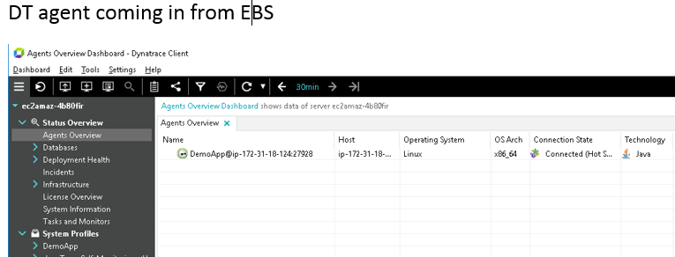
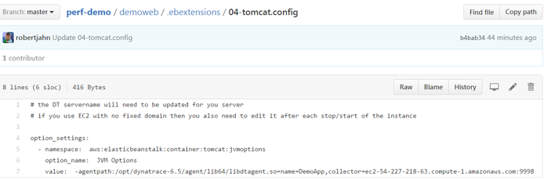
EBS Configuration

Slide 45
Backup

Slide 46
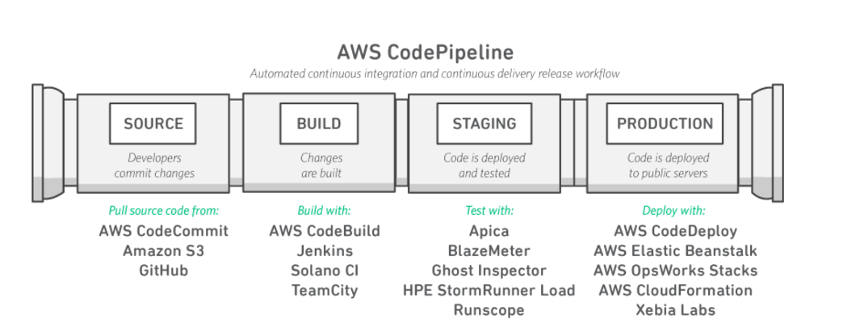
What is the AWS CodePipeline?
AWS CodePipeline is a continuous integration and continuous delivery service for fast and reliable application and infrastructure updates. CodePipeline builds, tests, and deploys your code every time there is a code change, based on the release process models you define.
3 Minute Explainer Video on https://aws.amazon.com/codepipeline/

Slide 47
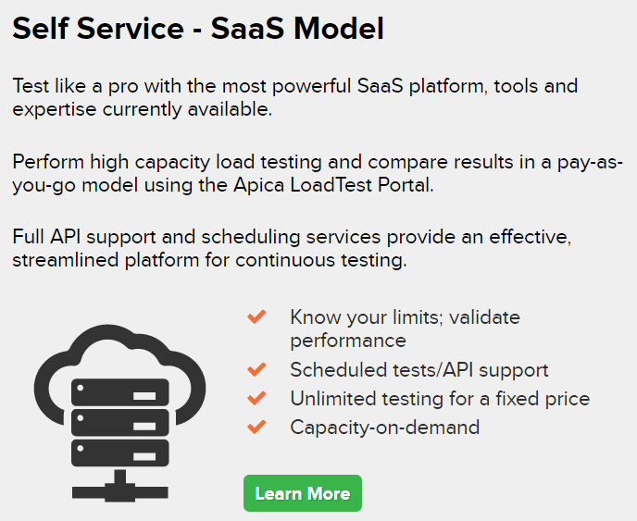
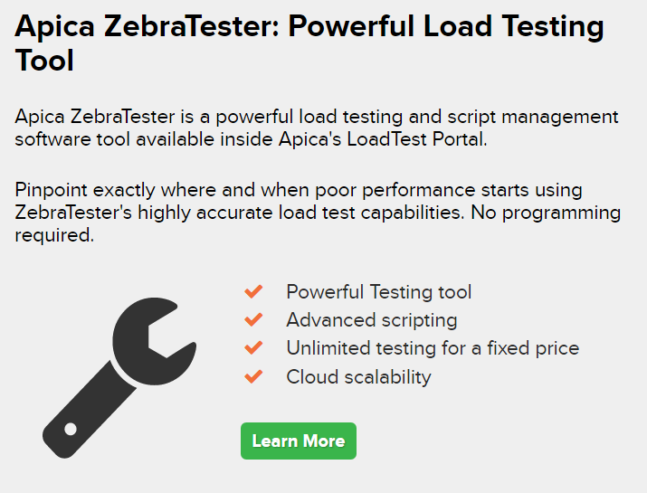
Apica Saas and Zebra Tester
Learn more at https://www.apicasystem.com/load-testing/

Slide 48
Scaling Continuous Innovation with Dynatrace on AWS: Shift-Left Quality, Reduce Lead Time & Increase Flow
Dev&Test: Check-In Better Code
Ops/Biz: Monitor End User and Resource Health
Test / CI: Stop 80% of Bad Builds Early
Performance: Production Ready Checks on Good Builds Only!
Notes:
Dynatrace allows you to Scale your Pipeline. Whether you run it full yon the Amazon or in hybrid Pipelines, e.g: using Jenkins or other tools such as XebiaLabs, Electric Cloud, SauceLabs, ...

Slide 49
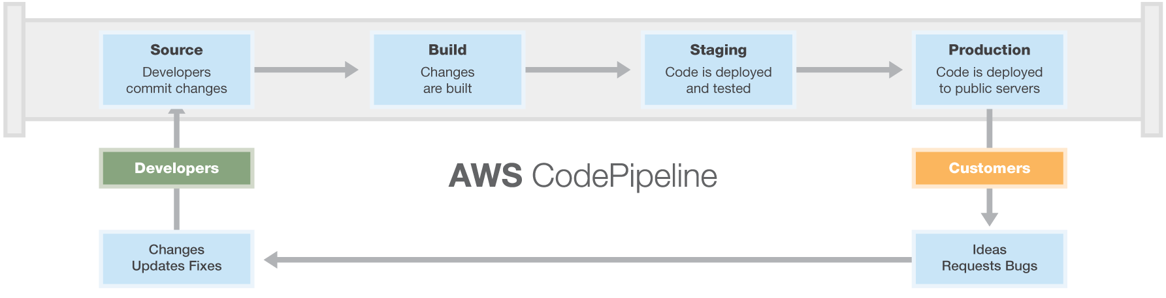
What is the AWS CodePipeline?
#1: Dev Checks in Code!
„A Commit“ to AWS CodeCommit, S3 or GitHub triggers the Pipeline. The commited code is the „Output Artifact“ for the next phase!
#2: Building!
Execute a Job in Jenkins or Solano CI. Result is another „Output Artifact“
#3: Testing
Execute Jenkins, Apica, Ghost Inspector, Runscope API to test your „Output Artifact“
#4: Deploy in Staging or Production
Deploy any Output Artificat using AWS Cloud Formation, AWS CodeDeploy, AWS Elastics Beanstalk
3 Minute Explainer Video on https://aws.amazon.com/codepipeline/

Slide 50
Dynatrace: Automatic Performance Analysis Across Load Tests
Auto Regressions and Root Cause Analysis across Tests
Learn more @ https://www.dynatrace.com/capabilities/load-testing/
Notes:
If you run load tests we automatically detect root cause within a single test but also detect regressions across tests. This not only speeds up your load testing phase but also helps you detect regressions from build-to-build faster

Slide 51
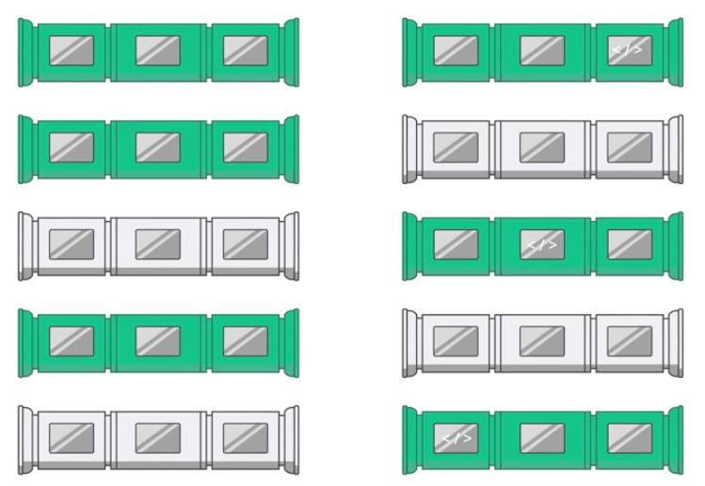



AWS + Dynatrace => Faster Lead Times, Better Quality
Optimal Lead Time with 1 Build in Pipeline
Happy Users
Keeping Optimal Lead Times with Many Builds
Notes:
With AWS and Dynatrace we make sure that you can keep pushing good code faster through the pipeline by stoping bad code changes earlier! This results in faster lead times, better quality and happy users

Slide 52
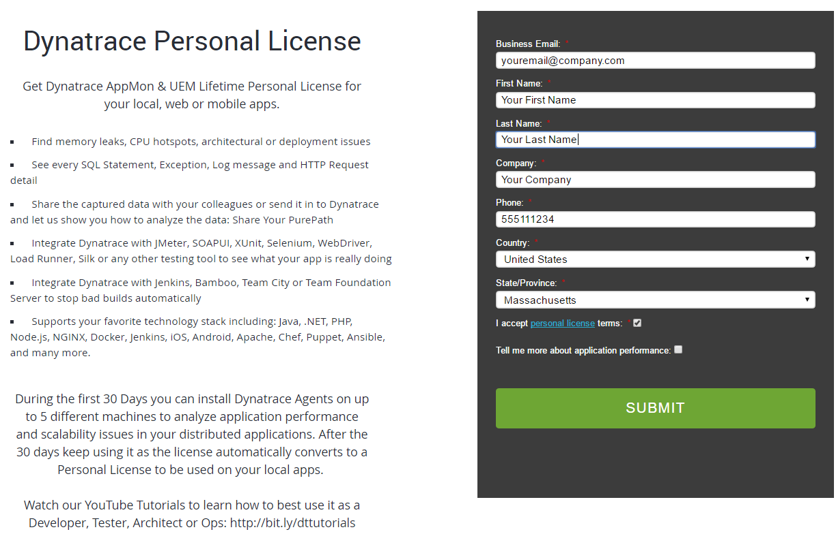
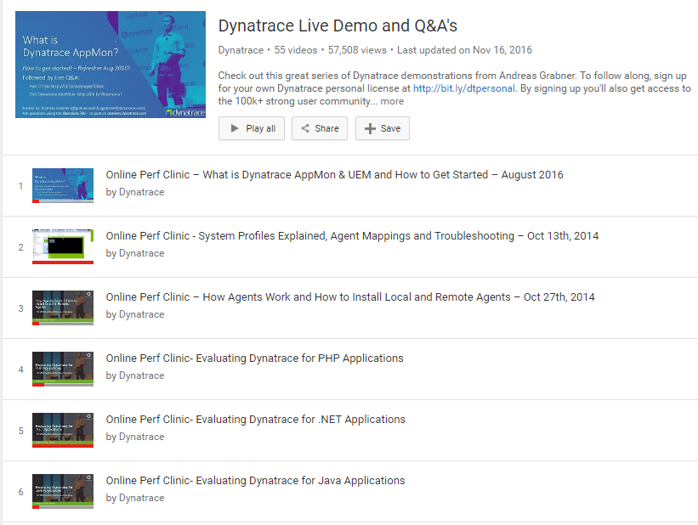
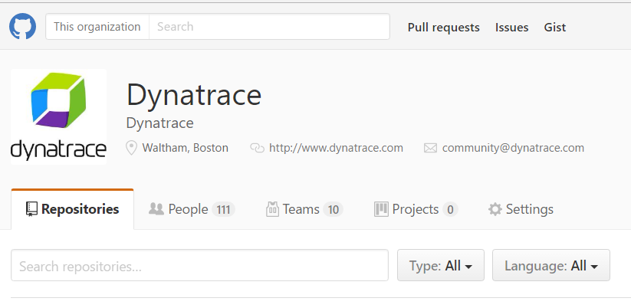
Get Started with 3 Simple Steps
Step #1: License
http://bit.ly/dtpersonal
Step #2: Learn
http://bit.ly/dttutorials
Step #3: Expand
https://github.com/Dynatrace

Slide 53
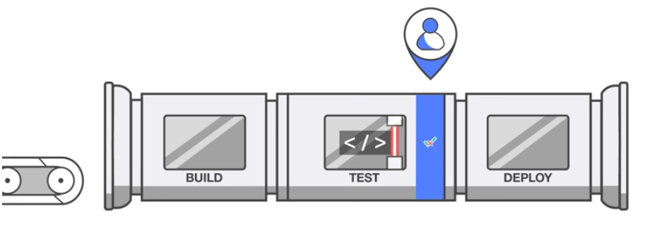
AWS DevOps Pipeline: Manual Approval and Regression Detection doesn‘t scale
Bottleneck
Notes:
With AWS DevOps Pipelines on their own you only have manual approval of phases. This is slow and error prone. Especially if you try to scale

Slide 54
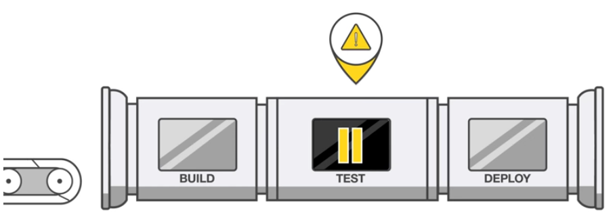
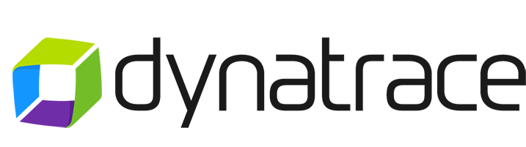
AWS + Dynatrace: Automatically Detect Architectural, Performance and Scalability Regressions
Auto Stop Bad Builds
Notes:
With Dynatrace we automate the detection of bad builds. We automatically detect anomalies and regressions for you.

Slide 55
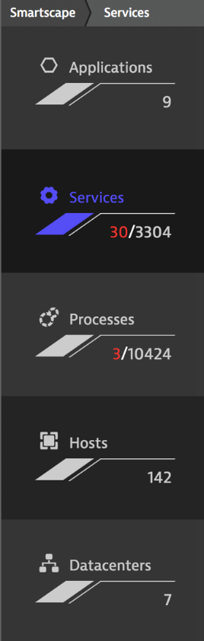


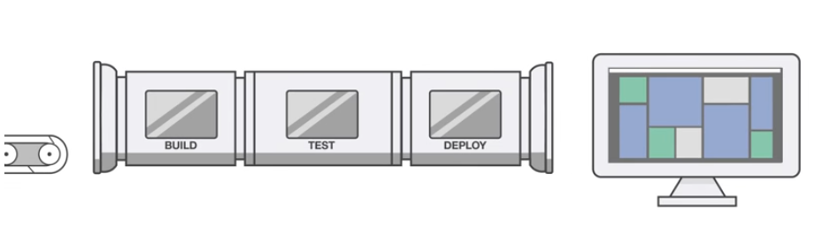

AWS + Dynatrace: Closing the Feedback Loop by automatically monitoring your Deployment
Notes:
Dynatrace not only speeds up your Pipeline but keeps monitoring your deployed applicaiton. Did the deployment had the desired impact? Are end users happy? How about resource consumption after the latest upgrade? Are all sites accessible without issues?

